Slide 1
Software Verification Validation and Testing
Presented by : Neha Tripathi

Slide 2
Validation activities
Verification and Validation activities
Validation and its activities

Slide 3
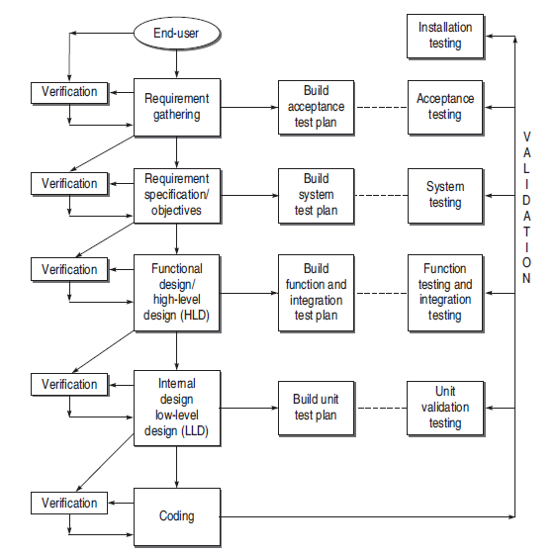
Verification and Validation activities

Slide 4
Validation
Validation is needed for:
To determine whether the product satisfies the users’ requirements, as stated in the requirement specification.
To determine whether the product’s actual behavior matches the desired behavior, as described in the functional design specification.
It is not always certain that all the stages till coding are bug-free. The bugs that are still present in the software after the coding phase need to be uncovered.
Validation testing provides the last chance to discover bugs, otherwise these bugs will move to the final product released to the customer.
Validation enhances the quality of software.

Slide 5
Validation activities
The validation activities are divided into:
Validation Test Plan and
Validation Test Execution

Slide 6
Validation Test Plan
It starts as soon as the first output of SDLC, i.e. the SRS, is prepared. In every phase, the tester performs two parallel activities—verification at that phase and the corresponding validation test plan. For preparing a validation test plan, testers must follow the points described below.
Testers must understand the current SDLC phase.
Testers must study the relevant documents in the corresponding SDLC phase.
On the basis of the understanding of SDLC phase and related documents, testers must prepare the related test plans which are used at the time of validation testing. Under test plans, they must prepare a sequence of test cases for validation testing.

Slide 7
The following test plans have been recognized which the testers have already prepared with the incremental progress of SDLC phases:
Acceptance test plan This plan is prepared in the requirement phase according to the acceptance criteria prepared from the user feedback. This plan is used at the time of Acceptance Testing.
System test plan This plan is prepared to verify the objectives specifi ed in the SRS. Here, test cases are designed keeping in view how a complete integrated system will work or behave in different conditions. The plan is used at the time of System Testing.
Function test plan This plan is prepared in the HLD phase. In this plan, test cases are designed such that all the interfaces and every type of functionality can be tested. The plan is used at the time of Function Testing.
Integration test plan This plan is prepared to validate the integration of all the modules such that all their interdependencies are checked. It also validates whether the integration is in conformance to the whole system design. This plan is used at the time of Integration Testing.
Unit test plan This plan is prepared in the LLD phase. It consists of a test plan of every module in the system separately. Unit test plan of every unit or module is designed such that every functionality related to individual unit can be tested. This plan is used at the time of Unit Testing.

Slide 8
Validation Test Execution
Validation test execution can be divided in the following testing activities:
Unit validation testing: unit testing is a process of testing the individual components of a system
Integration testing: Test the error in the interface , the intention here is to uncover the bugs that are present when unit tested modules are integrated.
Function testing: Tests verify that the system behaves correctly from the user/business perspective and functions according to the requirements, models, or any other design paradigm used to specify the application
System testing: test the whole system on various grounds where bugs may occur.
Acceptance testing: is defined as the process of comparing the final system with the needs of customer as agreed on the acceptance criteria.
Installation testing: tests the process of making the software operational. The installation process must identify the steps required to install the system.

Slide 9
Thank You!

